Slide 1
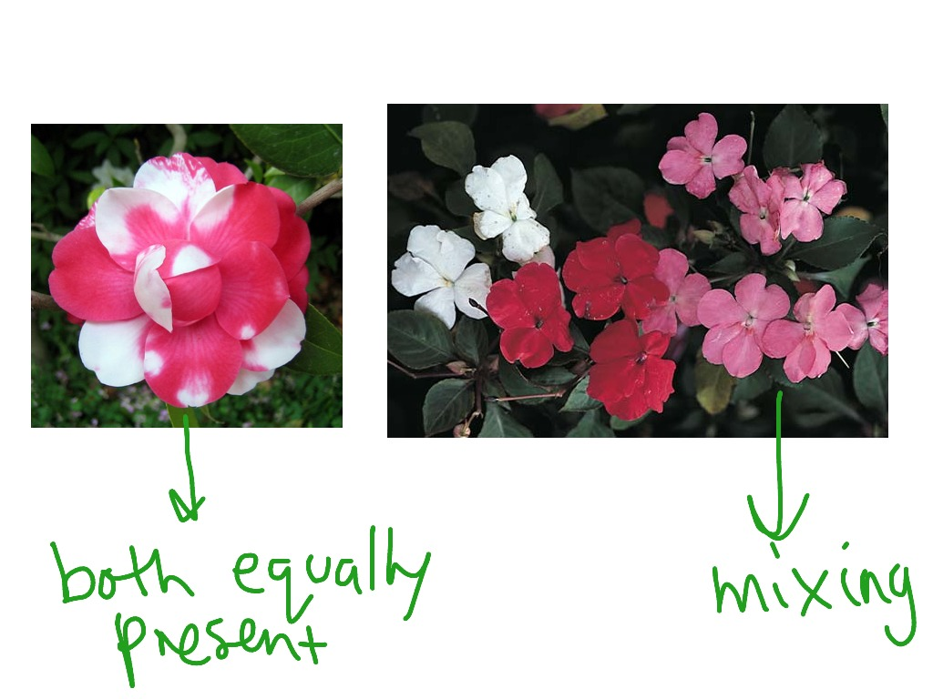
Codominance and Incomplete Dominance

Slide 2
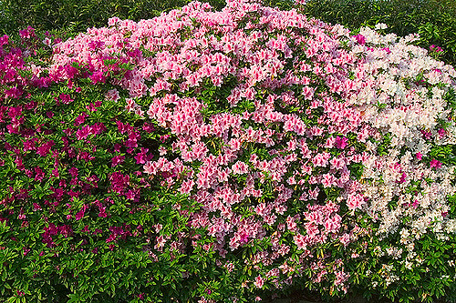
Incomplete Dominance - When traits blend, similar to mixing of paint colors.
For example: The colors of some petals...
These flowers are called four o’clocks. A red parent crossed with a white parent makes a hybrid pink offspring.

Slide 3
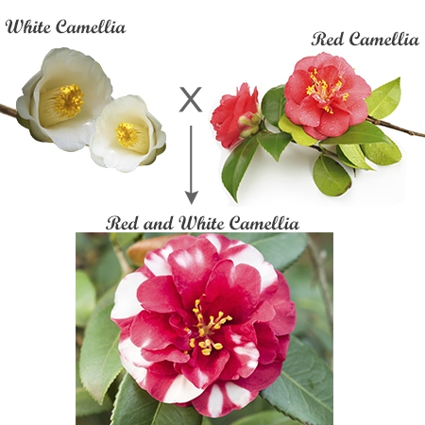
Codominance is when 2 traits form patterns such as stripes, spots, or roan in the hybrid. .Both phenotypes are visible in the same organism.

Slide 4
Another example of codominance is a roan coat on an animal:
Codominance
The term roan is used when the fur is made up hairs which are either of 2 colors: Red and white hairs make a blended coat.

Slide 5
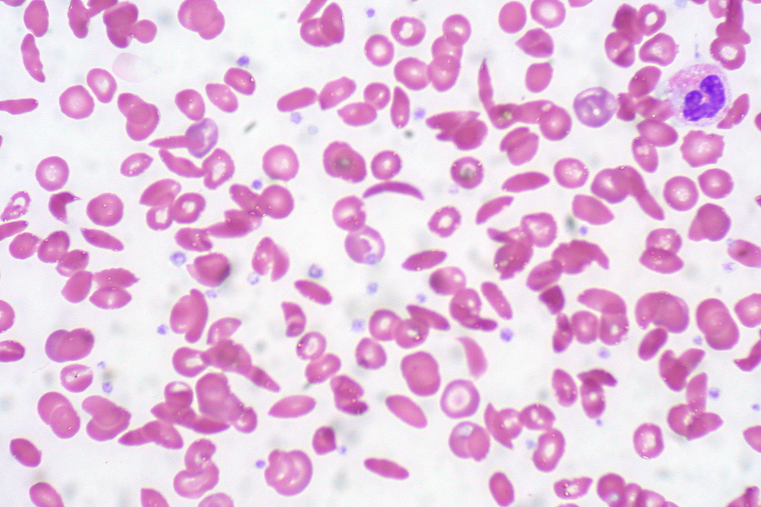
Some diseases follow the codominance pattern, such as sickle cell anemia.

Slide 6
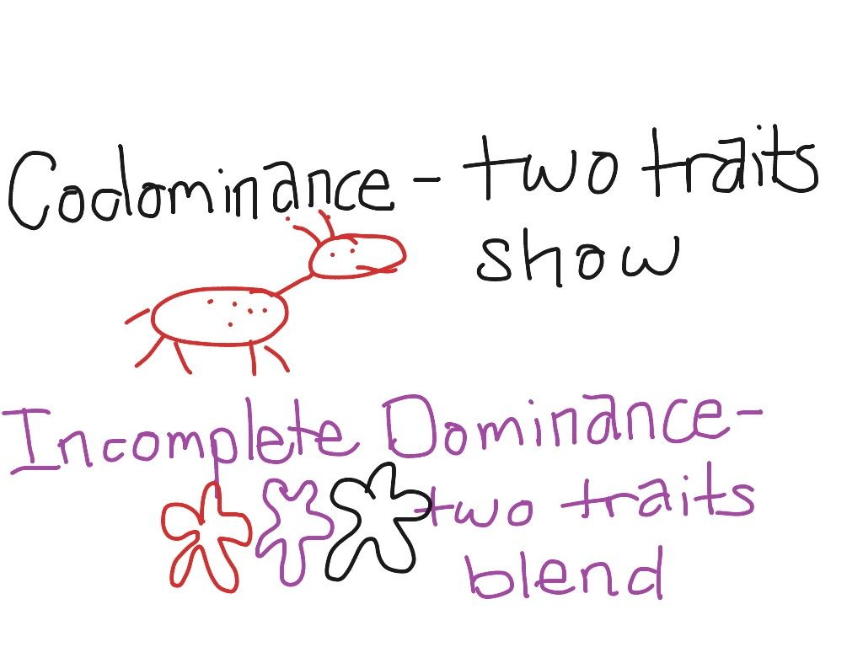

Slide 7
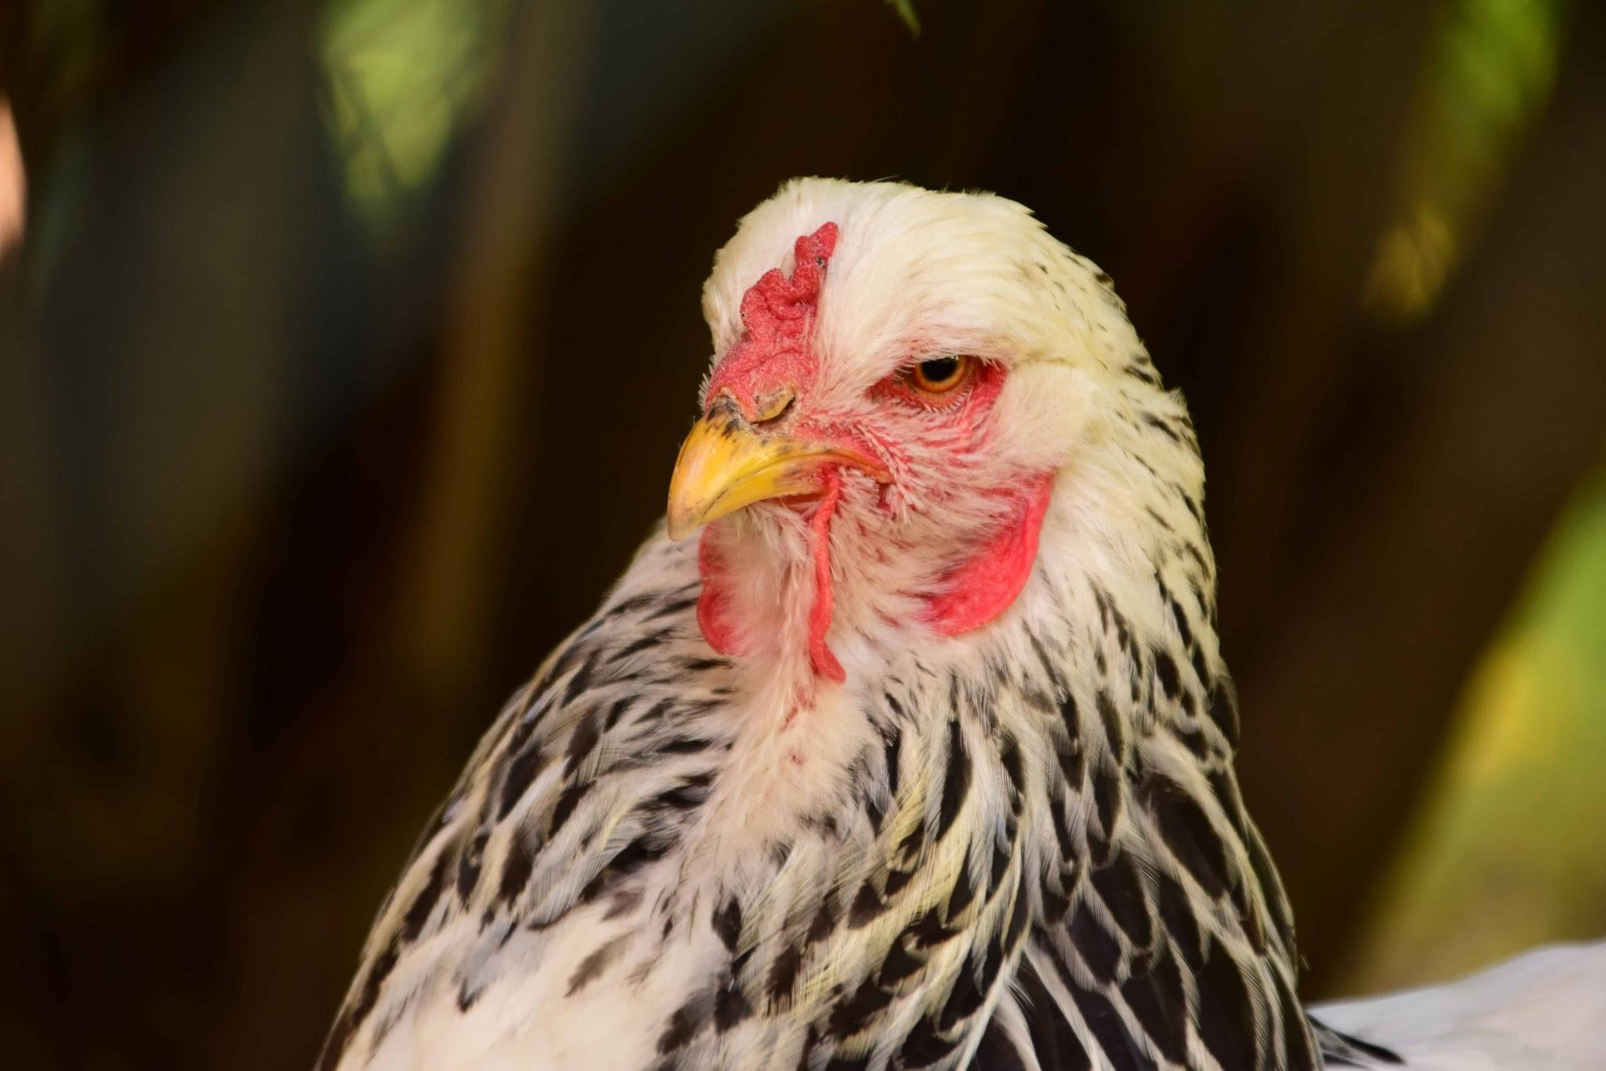
Punnett squares for both of these patterns involve 3 phenotypes.
Black, White, Striped
BB WW BW
Note: The two pure traits have 2 of the same alleles.
The hybrid has one of each allele.

Slide 8
Follow these steps for the Punnett Square problems:
Write down the 3 phenotypes described in the problem.
2. Determine which are pure traits and which one is the hybrid.
3. Assign letters to the pure traits. Give them 2 alleles that are the same. Give the hybrid one of each allele.
4. Reread the problem and create the cross. Set up the Punnett.

Slide 9
Example: A yellow rose is crossed with an orange rose which produces a yellow-orange offspring. Explain how this could happen using a punnett square.
Yellow orange yellow-orange
YY
OO
OY
YY X OO

