Slide 1
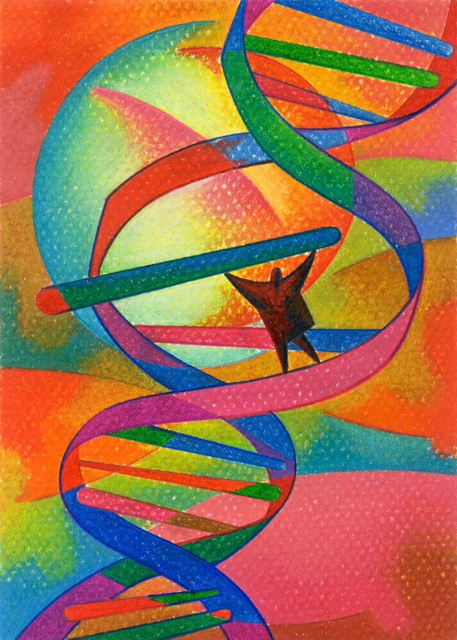
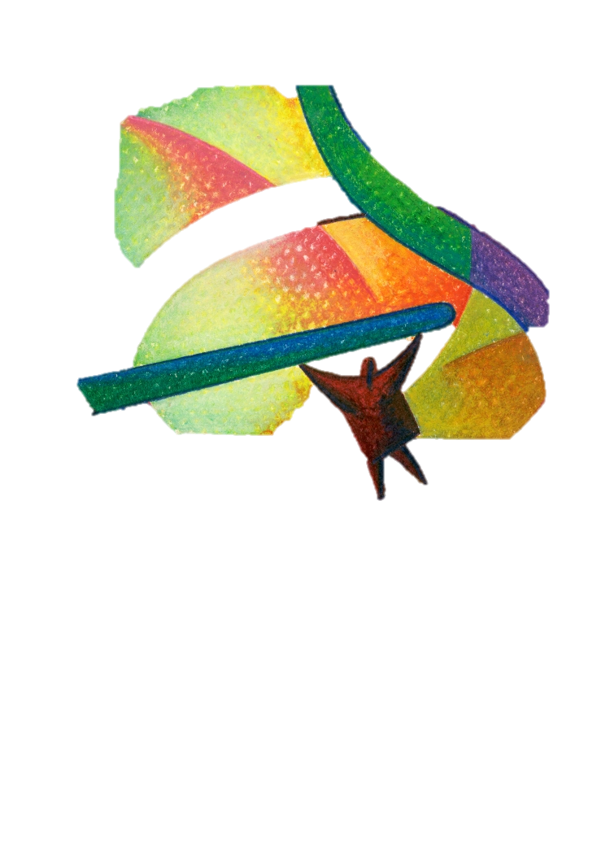
DNA
A molecule that can copy itself!

Slide 2
DNA has a primary purpose
to store and transmit
the genetic information
that tells cells
what proteins to make
and when to make them

Slide 3
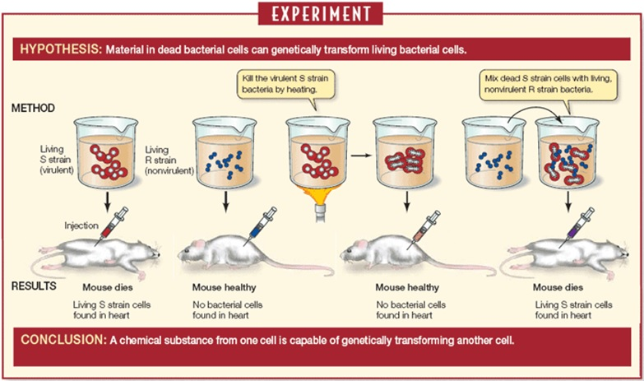
How did scientists discover that DNA was the heredity molecule?
Frederick Griffith, Britain, 1928: TRANSFORMATION HAPPENS!!

Slide 4
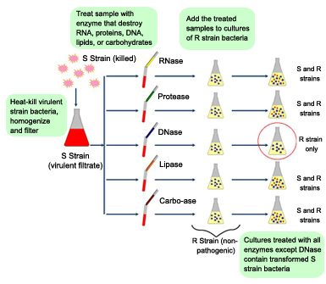
Oswald Avery: Canada, 1944
Proves that DNA is the molecule that causes transformation

Slide 5
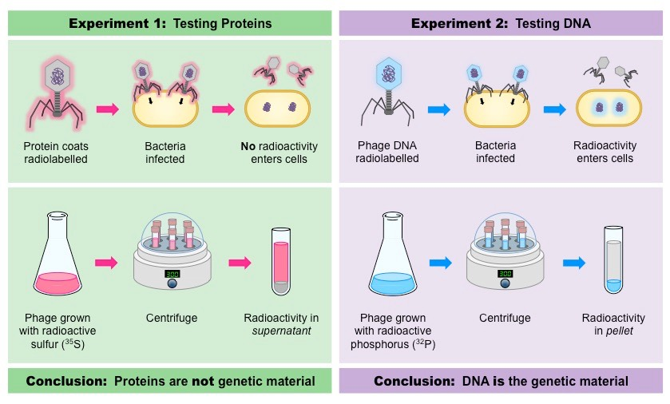
Alfred Hershey and Martha Chase: United States: 1952
Proved that Virus transfers DNA into cells, not protein

Slide 6
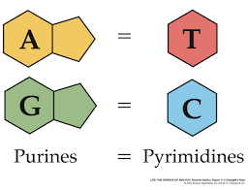
Once DNA was proven as the molecule of inheritance, then the race to describe its structure was on!
They knew that DNA contained 4 different bases: Adenine (A)
Thymine (T), Guanine (G) and Cytosine (C).
Erwin Chargaff: United States: early 1950’s. He proved that
There were equal amounts of Adenine and Thymine, also of Guanine and Cytosine

Slide 7
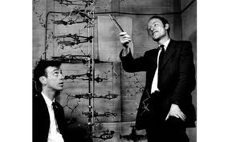
DNA’s structure was described in 1953
James Watson, an American and Francis Crick , British, were the first to describe the double helix structure of DNA .

Slide 8
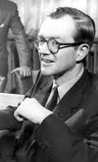
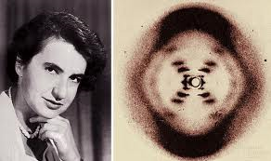
Major contributions came from Rosalind Franklin and Maurice Wilkins.
Wilkins and Franklin worked in the same lab but independently from one another.
This famous x-ray crystallography image was the final piece to the puzzle.

Slide 9
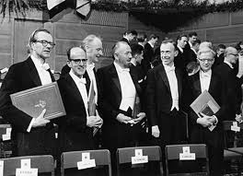
Watson, Crick and Wilkins
received the Nobel Prize
in medicine in 1962
for the description of
DNA’s structure and function.
Rosalind Franklin had died
in 1958 and thus was not
recognized.

Slide 10
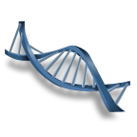
DNA stands for Deoxyribonucleic Acid.
It is found in the nucleus of eukaryotic cells, in the cytoplasm of prokaryotic cells, and in many viruses.

Slide 11
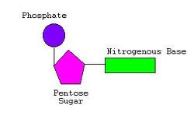
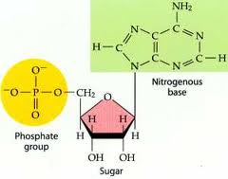
DNA is made up of monomers
called nucleotides.
A nucleotide
Each nucleotide contains a phosphate group,
a sugar (deoxyribose),
and a nitrogen base.

Slide 12
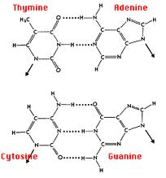
There are 4 different
Nitrogen bases:
Adenine (A)
Thymine (T)
Cytosine (C)
Guanine (G)
The bases consistently pair up
Adenine with Thymine ( A – T)
Cytosine with Guanine. (C – G)
Their hydrogen bonding aligns
so they always pair up this way.
This is referred to as
the base pairing
rule or complementary
base pairing.

Slide 13
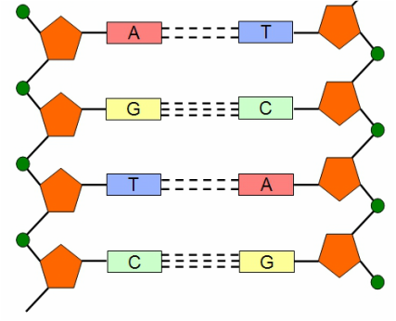
The sugar and phosphate groups make up the sides
of the ladder. ( one side 5’ to 3’, the other 3’ to 5’)
The ‘rungs’ contain the base pairs.
The base pairs are held together by weak hydrogen bonds.
All other bonds are covalent bonds.

Slide 14
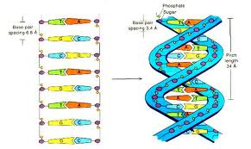
The molecule spirals into
a double helix (a twisted ladder).

Slide 15
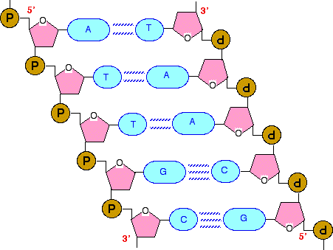

Slide 16
DNA Replication
Replication is defined
as the process of
making a copy of a
DNA molecule.
It occurs before every cell division.
When the cell divides,
each receives one
of the DNA copies.

Slide 17
←
The process of replication can be
described in 3 steps:
Step 1: Enzyme DNA helicase binds
and breaks the DNA molecule between
the bases at the hydrogen bonding site.

Slide 18
Step 2:
Free floating
nucleotides
attach to the
unpaired bases.

Slide 19
Step 3:
Enzyme DNA polymerase
links the sugar to phosphate
of the newly attached nucleotides.
DNA helicase
enzyme

Slide 20
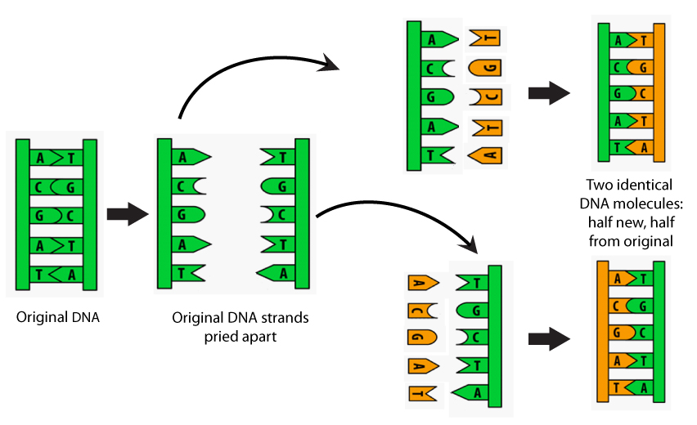
The result is 2 identical
double stranded DNA molecules.

