Slide 1
Energy in Matter and Chemical Reactions

Slide 2
Energy is defined as the ability to do work or cause change.
Some forms of energy in biological systems include:
Chemical energy
Electrical energy
Thermal energy
Mechanical energy

Slide 3
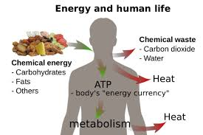
Free energy is the energy in a system that is available for work.
For example, in a cell, it is the energy that is available to fuel cell processes.
As energy flows through a single organism, it may be converted from 1 form to another.
For example, your last meal is now being converted from chemical energy found in food into thermal and mechanical energy .

Slide 4
States of Matter
All atoms and molecules are in constant motion.
The rate at which they move determines its state: solid, liquid or gas
Energy is added to the system to change from solid to liquid to gas.

Slide 5
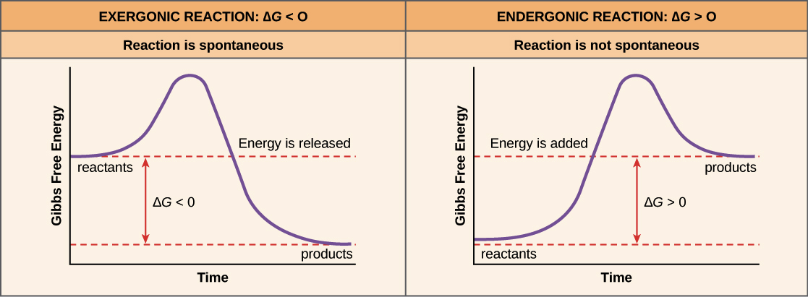
Energy and Chemical Reactions
As chemical reactions progress, energy may be required or released.

Slide 6
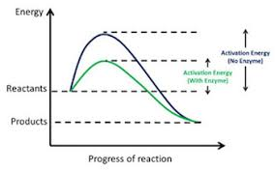
Activation energy – the amount of energy needed to start a reaction
Some substances lower the amount of activation energy
needed to start a reaction. They are called catalysts.
Living things contain enzymes, which are an important class of catalysts.
An organism may have thousands of different enzymes, each tailored for a different chemical reaction.

Slide 7
Reduction-Oxidation Reactions
Many of the chemical reactions that help transfer energy in living things involve the transfer of electrons.
These reactions are called redox reactions.
Oxidation reactions happen when a reactant loses one or more electrons, becoming more positive in charge.
Reduction reactions happen when a reactant gains one or more electrons, becoming more negative in charge.

