Slide 1

Scientific Inquiry

Slide 2
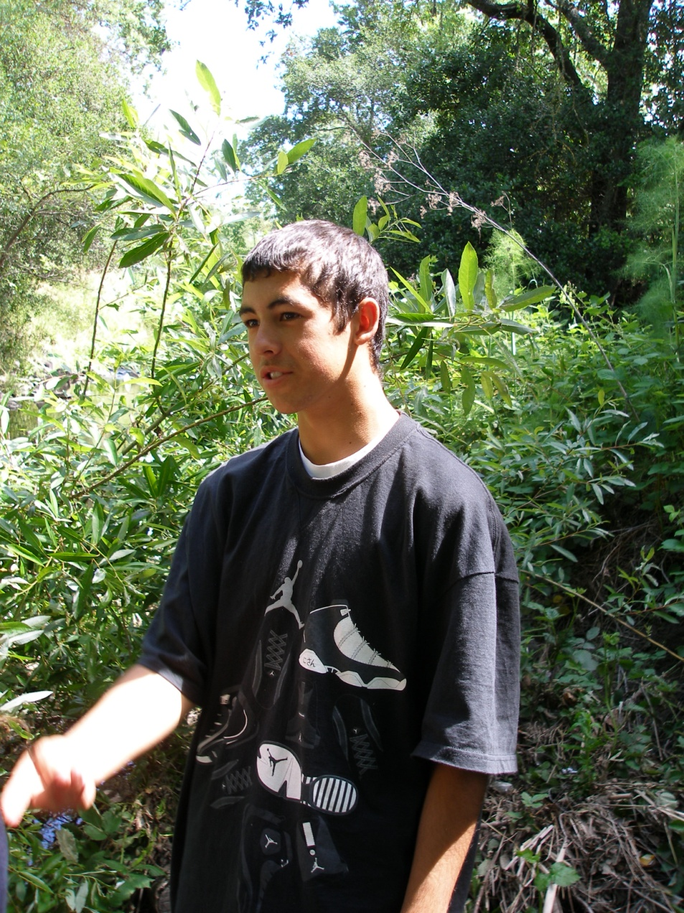
Scientific Inquiry is a name for the process of finding answers to questions about how things work in the natural world.

Slide 3
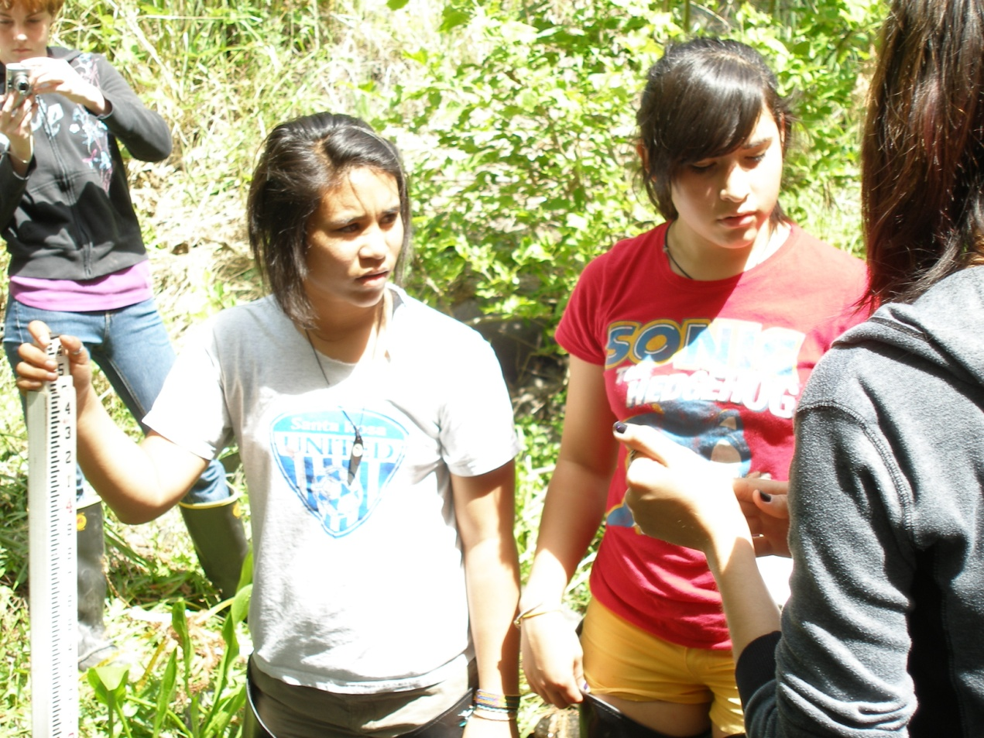
Scientists ask a specific question, then guess at what they think the answer might be.

Slide 4
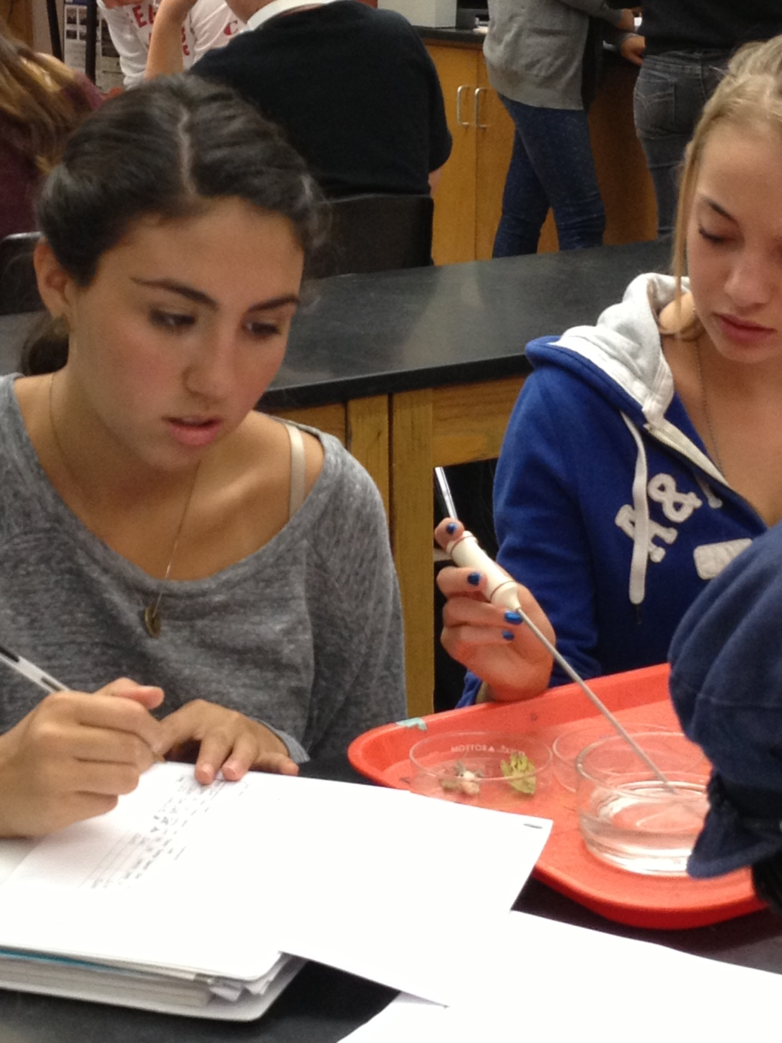
Then they design an experiment that is aimed at checking whether their guess was right or not.

Slide 5
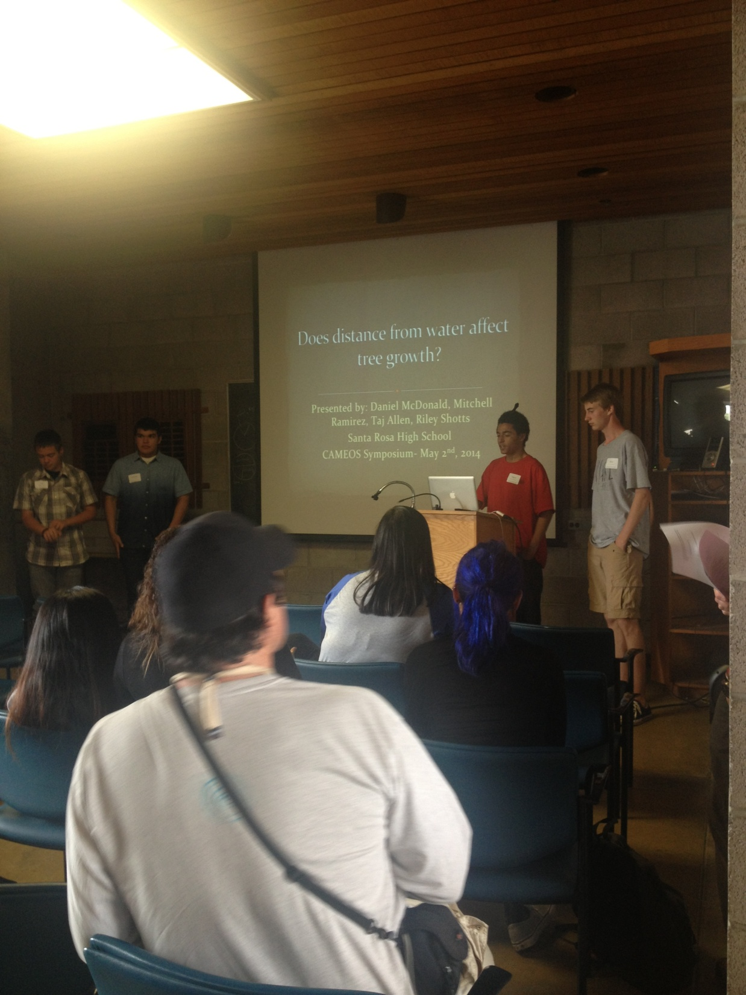
The results and conclusion leads the investigator to the next questions.

Slide 6
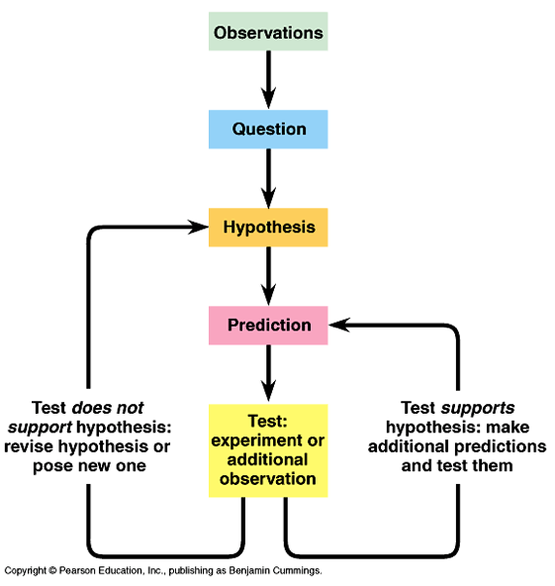
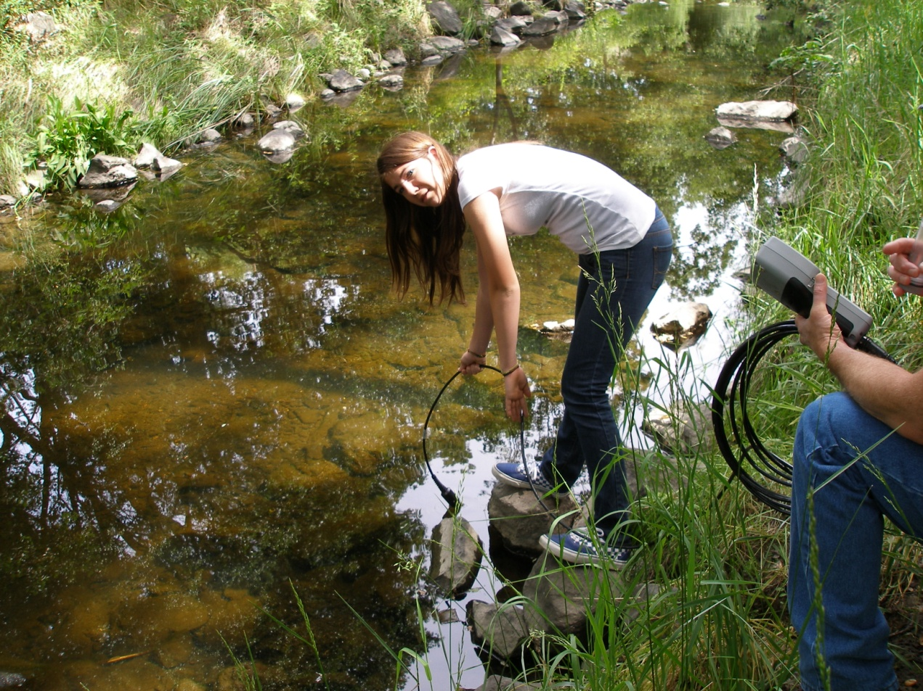
Scientific inquiry flow chart

Slide 7
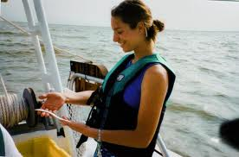
There are 3 types of studies that are commonly used in biology.
The observational study
The controlled experiment
The epidemiological study

Slide 8
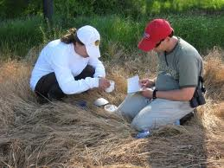
The observational study:
The observational study is an experimment in which the researcher carefully observes and records observations with minimal interference with the biological subject.

Slide 9
Observation
All scientific studies require objective, accurate observation skills.
There are two basic types of observations:
qualitative and quantitative.
.

Slide 10

Observations that are made without a measuring device are called qualitative observations.
These observations record qualities of something.

Slide 11
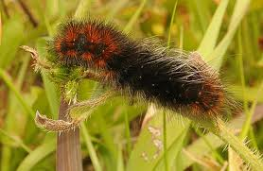
Qualitative observation examples: the odors, textures, shapes, impressions, sound, tastes, behaviors…
Write a qualitative observation about the wooly bear caterpillar above

Slide 12
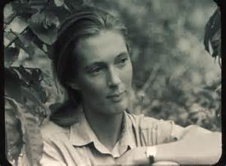
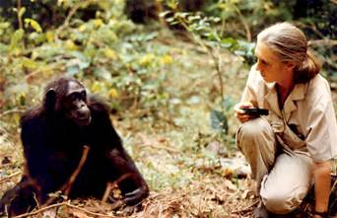
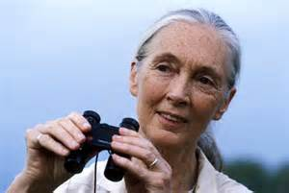
Jane Goodall’s chimpanzee studies
were largely qualitative
observational studies.

Slide 13
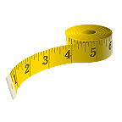
Observations which contain a measurement
or count of something
are referred to as
quantitative observations..
Typically, a measuring device is used.
Quantitative measurements are
extremely important when trying to prove the validity of an experiment.

Slide 14
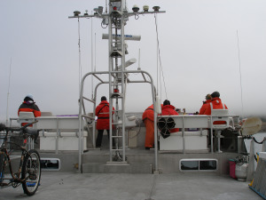
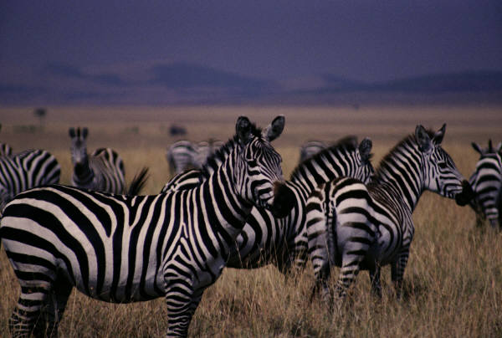
Examples would be the dimensions of something, how much magnification
was used, counting how many of something there may be.
These biologists are counting birds and mammals which are close to the ocean surface.

Slide 15
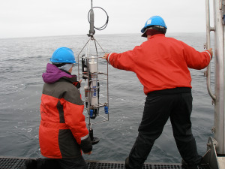
Example: monitoring studies that count which species are present and in what quantities.
How marine abiotic parameters are measured

Slide 16

Another method of study is the controlled experiment. It is a manipulative experiment which compares 2 or more groups to test a hypothesis.
The two groups are called the control group and the experimental group

Slide 17
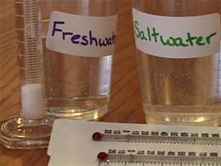
The control group is used for comparison to the other group.
The experimental group is the manipulated group.

Slide 18
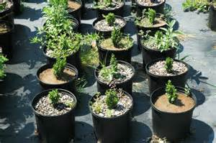
This controlled experiment
is testing the effects
of different factors to
control weeds in
potted plants.
What might the experimental group be?
What might the control group be?

Slide 19
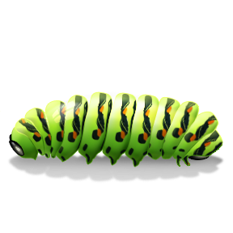
In a controlled experiment, factors are controlled and manipulated.
It is also called the manipulated variable
The factor you choose to manipulate is the independent variable.
The reaction to that factor is called the dependent variable.
It is also called the responding variable

Slide 20
An independent variable is also called the manipulated variable
The dependent variable is also called the responding variable

Slide 21
What would be the independent variable here?
What would be the dependent variable here?

Slide 22

The Epidemiological Study
is a study that involves large-scale comparisons among groups of organisms, usually contrasting a group known to have been exposed to some toxicant and a group that has not.

Slide 23
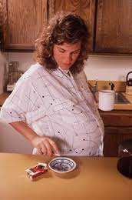
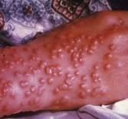
Epidemiological studies are used to
learn about birth defects and
diseases.
Pregnant smoker
Small pox

